Slide 1
Git Introduction
Notes:
I don’t own the pictures in the presentation. Ownership goes to the original creators

Slide 2
Agenda
What is Git?
What is GitHub?
Example
Git terminology

Slide 3

What is Git?
Git is a Distributed Version Control System. Linus Torvalds initially authored Git.
Git keeps track of the changes they make to code.
Git’s Distributed nature makes it easy for programmers to work together on the same code. They can share their changes with others and even combine them into one code.
GitHub, GitLab, BitBucket etc are code hosting platforms for git version control.

Slide 4
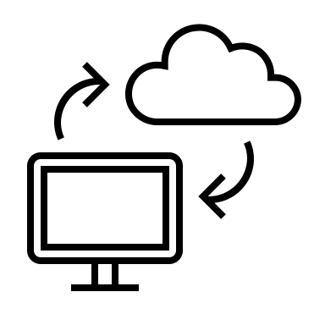






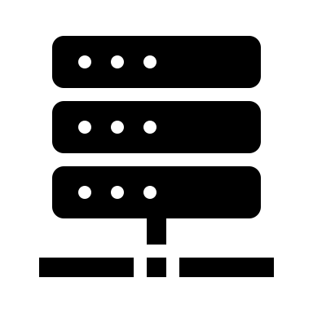





Layman's terms example?
Google drive
GitHub

Slide 5
Git Terminology
Repository: It's like a folder containing a project's files and metadata like the file's version history
Local: Repository stored in your computer or any computer
Remote: Repository stored in an internet server like GitHub, GitLab, or BitBucket.

Slide 6


Git Terminology
Commit: A point for file changes, like a milestone marker on the road.
Push and Pull operation:
Push is an operation to move the commit changes from the local to the remote repository
Pull is an operation to update commit changes from the remote to the local repository
Push
Local
Git Repository
Pull

